Slide 1
Ensembles of Decision Trees:
2. Gradient Boosting:
The gradient boosting algorithm is a powerful ensemble machine learning technique that builds predictive models in a sequential, stage-wise fashion. It combines multiple "weak learners," typically decision trees, to create a single, robust "strong" model that minimizes overall prediction errors by learning from the mistakes of the previous models.

Slide 2
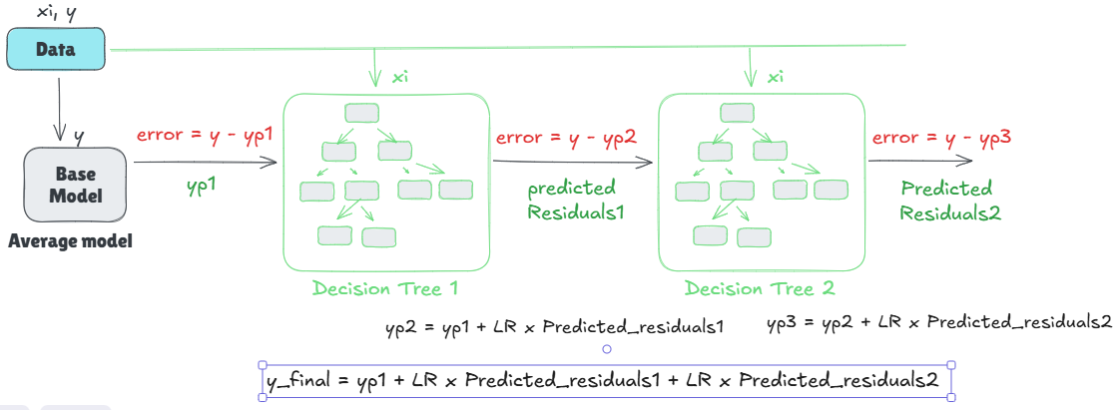
Ensembles of Decision Trees:
1. Gradient Boosting:

Slide 3
Ensembles of Decision Trees:
Steps in Gradient Boosting:
We will create a base model → Average model or most frequent categories.
Calculate residuals (error) from average prediction and actual values.
Now create another model Decision Tree 1(DT1), which will take xi as input and residuals as target.
Now we have new predicted target values by DT1.
Now we will calculate residuals (error) again from (actual – DT1_predicted).
New model DT2 will fit again on input xi and residuals as target

Slide 4
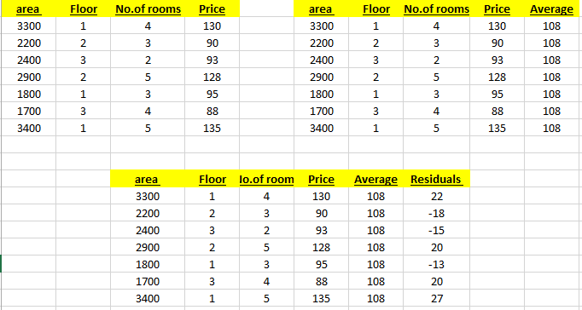
Ensembles of Decision Trees:
Steps

Slide 5
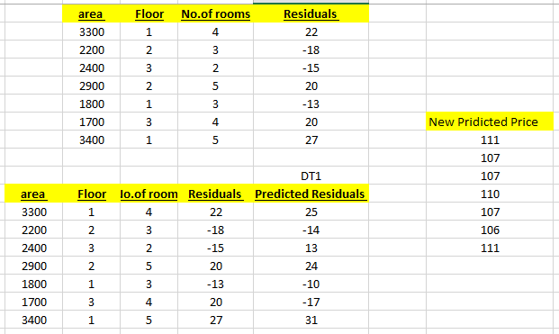
Ensembles of Decision Trees:
Steps
New predicted price (DT1) = Average predicted value + LR * Predicted Residuals

Slide 6
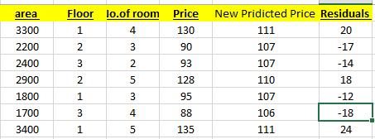
Ensembles of Decision Trees:
Steps

